Slide 1
J-Unit Testing
MC22F14F053
MC22F14F049
MC22F14F002

Slide 2
What is J-Unit testing ?
JUnit is a unit testing open-source framework for the Java programming language.
Java Developers use this framework to write and execute their code.
In Java, there are test cases that have to be re-executed every time a new code is added.
JUnit is a regression-testing framework, that devs used to write unit test
This framework creates a relationship between development and testing. You start coding as required specification and need to use those JUnit test runners to verify how much it deviates from intended goal

Slide 3
What is Unit testing ?
Software testing process where individual components / units are tested
The purpose is to validate each unit of software performs as designed
Main aim is to isolate each unit to identify, analyze and fix defects.
It tells that each part of program and the individual part are correct

Slide 4
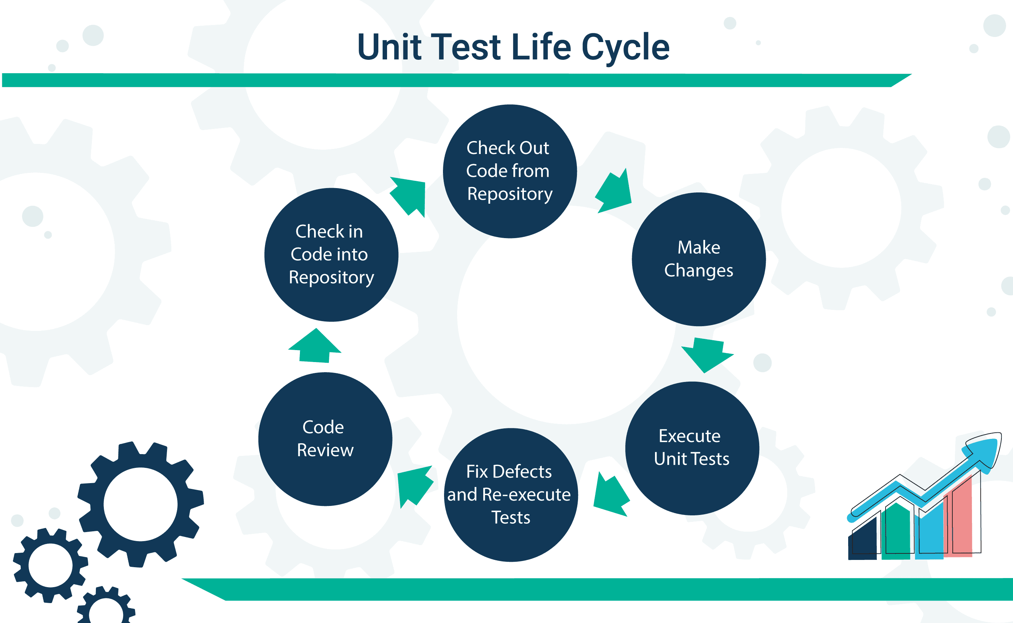
What is Unit testing ?

Slide 5
What is Regression testing ?
It is the process that is done to find errors in the system after doing any changes in the software or product
It is performed when you change or modify a piece of code
There are tools which are used for Regression Testing
Quick Test Professional
Rational Functional Tester
Selenium

Slide 6
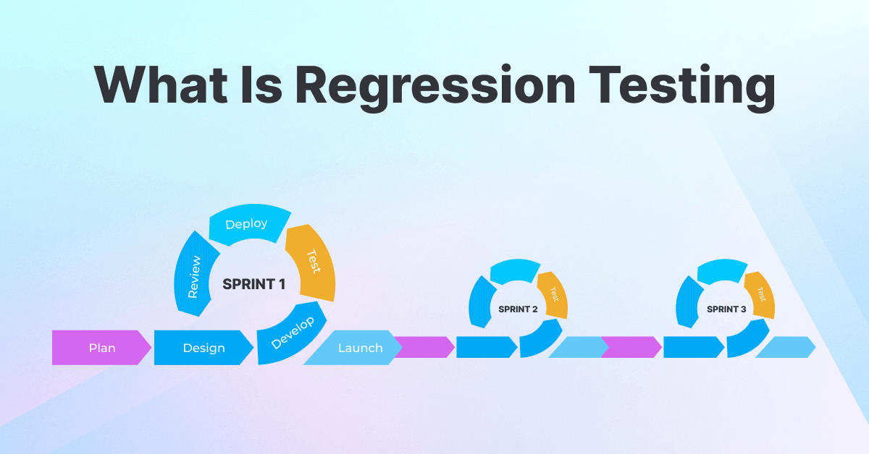
What is Regression testing ?

Slide 7
H.323 Protocol
H.323 is a multimedia conferencing protocol, which include voice, video and data conferencing for use over Packet-Switched network
Basically it is a standard specified for Packet-Based multimedia communication system by ITU or Internet Telephony Protocol aka VoIP

Slide 8
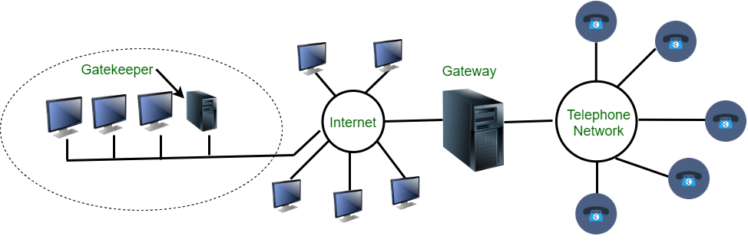
H.323 Protocol
At the center there is a Gateway placed which connect Internet to Telephone network. Gateway translates message from one protocol to another
It speaks H.323 on internet side and PSTN (Public Switch Telephone Network) protocol on telephone side.
A LAN may have gatekeeper which controls the terminals.

Slide 9
Types of JUnit Testing
The JUnit test case is the set of code that ensures whether our program code works as expected or not.
In Java, there are two technique of unit testing possible:
Black Box Testing – used to test UI, input and output
White Box Testing - used to test functionality and behavior

Slide 10
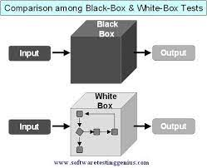
Types of JUnit Testing

Slide 11
Types of JUnit Testing
Additionally there are other types of testing as well
Manual Testing – Here, we execute test cases manually without help of any software
It is generally not recommended to use since it consumes a lot of time and human resource.
Also it is not as reliable as automated testing thus may result in errors.

Slide 12
Types of JUnit Testing
Automation Testing :
Here we use 3rd party tools to execute test cases thus we call it automated testing
It is faster than manual testing
Not only it saves time but improves accuracy and require less human resource

Slide 13
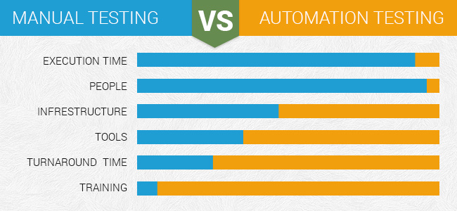
Types of JUnit Testing

Slide 14
Annotations in Junit Testing
@Test – to identify actual test cases
@Before – to execute some statement before each test case
@After – to execute some statement after test cases
@Ignores – to ignore some statement during execution or test
@BeforeAll – to execute some statement before all the test cases
@AfterAll – to execute some statement after all the test cases

